Slide 1
Online Gym Management System.

Slide 2

CONTENTS
01
Project Introduction
02
Project Architecture
03
Technology and Platform Used
04
User Roles and Responsibility
05
Division of Work within the Team
06
Known Issue if any
07
Future Extensions if any
08
Conclusion

Slide 3
01
Project Introduction
Gym management system is designed to simplify the running of a fitness club, from online gym activities scheduling and automated billing to administrative tasks. The system pulls all data into one place so that your business growth can be seen and you can run business more efficiently.

Slide 4
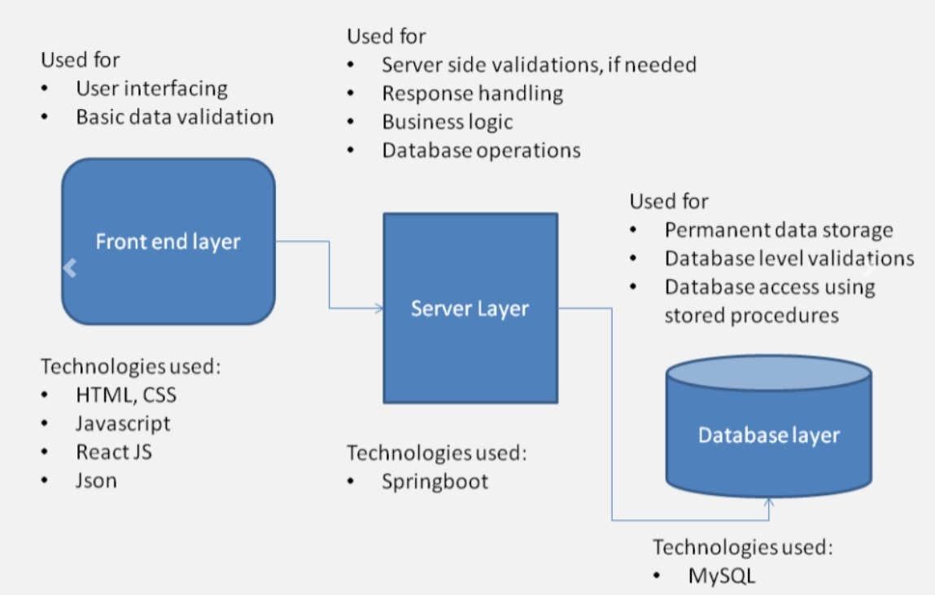
02
Project Architecture

Slide 5
03
Technology Platform used
Technology used
Front End : React JS
Server Layer : Spring Boot
Database : MySQL
Reasons for Selecting Specific Technology
REACT JS(single page app),Spring Boot(Easy to use framework),
MySQL(RDBMS, multi-row transactions, open source)

Slide 6
04
User Roles and Responsibility
Responsibility
Admin : Manage Gym Faculty, Manage Fund, Access to All Data
Manager : Manage Packages,Schedules, Payment, Trainers
Trainer : View Member, Create Diet and Workout Plans, Forward Requirements to manager.
Customer : View Website, Select Package ,Apply for membership, View Diet and Workout Plans.

Slide 7
05
Division of Work within Team
Whole Team worked together in the project parallel supporting each other and finding way through problems, bugs, trying different
approach.

Slide 8
06
Known issues if any
React Class Component issue.
Name of column in Entity and Database Not matching.
Foreign Key Constraint Failed.(Added FK after inserting Data)

Slide 9
07
Future Extension if any
Online Yoga Classes or Training Feature.
Online Batch Scheduling on Availability of both Customer and Trainer.
Making Chain of Local Gyms throughout Cities so that member of one gym can attend gym at many cities.

Slide 10
08
Conclusion
General Opinion about our Project.
Challenges we faced.
New things we learnt.
Our overall Experience During Project Phase

Slide 11
THANK YOU

